Slide 1
Lecture 9 – Routing Concepts and Static Routing
COMP1002 (Cybersecurity and Networks)

Slide 2
Overview
Routing concepts (ch 14, CCNA2)
Primary functions and features of a router
Connecting devices for a small network
Configure basic router settings using CLI
Verify connectivity between networks
Encapsulation/decapsulation
Path determination function of a router
Building a routing table
Static routing (ch 15, CCNA2)
Advantages and disadvantages
Configuration
Classful and CIDR addressing
Summary routes
Floating static routes

Slide 3
Functions of a router
To route!
Determine the best path for a packet
Forward the packet
A router connects one network to another network.
Communication between networks would not be possible without a router determining the best path to the destination and forwarding traffic to the next router along that path.
The router is responsible for the routing of traffic between networks.

Slide 4
Routing process
Router examines the destination IP of each received packet and decides what to do with it based on a routing table
Match found
Directly connected to the network – send the packet to destination
Not directly connected – forward it to another router
No match found – drop the packet
Routing – layer 3 (based on IP addresses)
Routers operate at layers 1,2, and 3

Slide 5
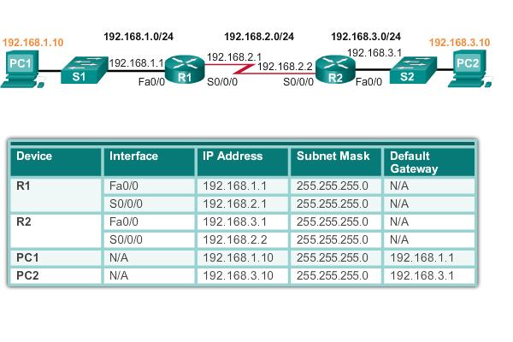
Documenting network addressing

Slide 6
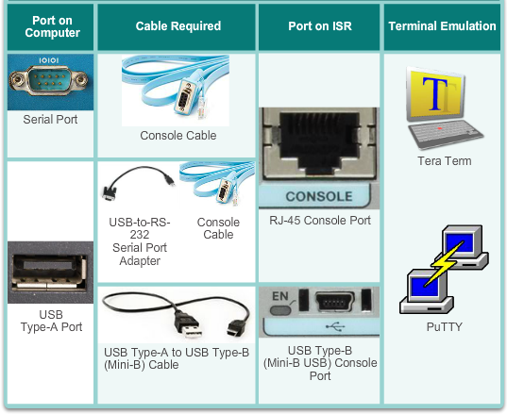
Console access
Notes:
ISR: integrated service router

Slide 7
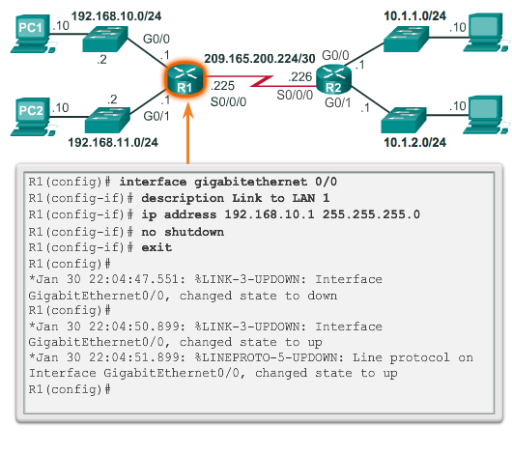
Configure interface

Slide 8
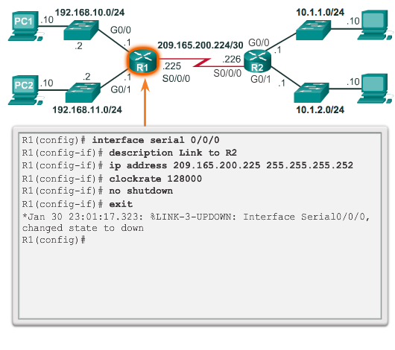
Configure serial interface

Slide 9
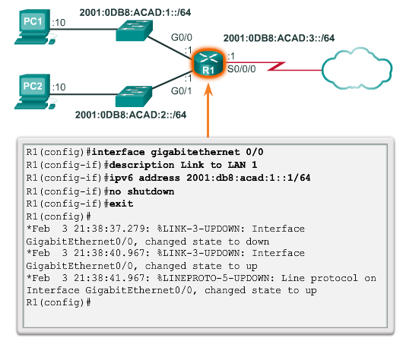
Configure ipv6 interface

Slide 10
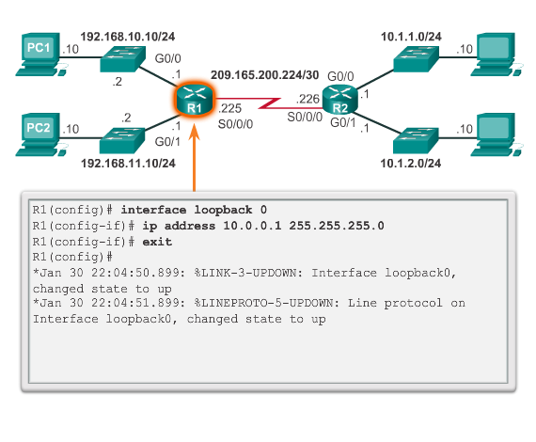
Configure loopback interface

Slide 11
show/output filters
section - Shows entire section that starts with the filtering expression
include - Includes all output lines that match the filtering expression
exclude - Excludes all output lines that match the filtering expression
begin - Shows all the output lines from a certain point, starting with the line that matches the filtering expression
sh ip int bri | include up

Slide 12
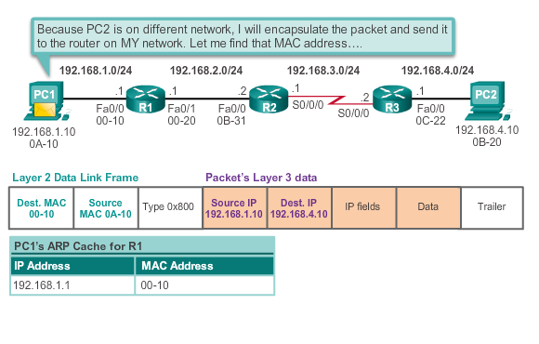
Send a packet – source PC to router

Slide 13
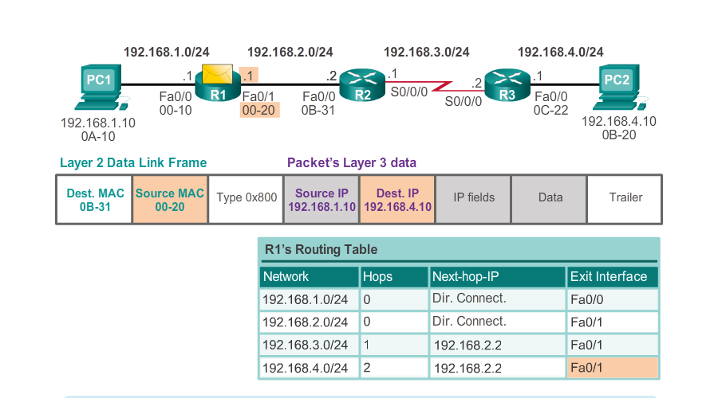
Send a packet – router to router

Slide 14
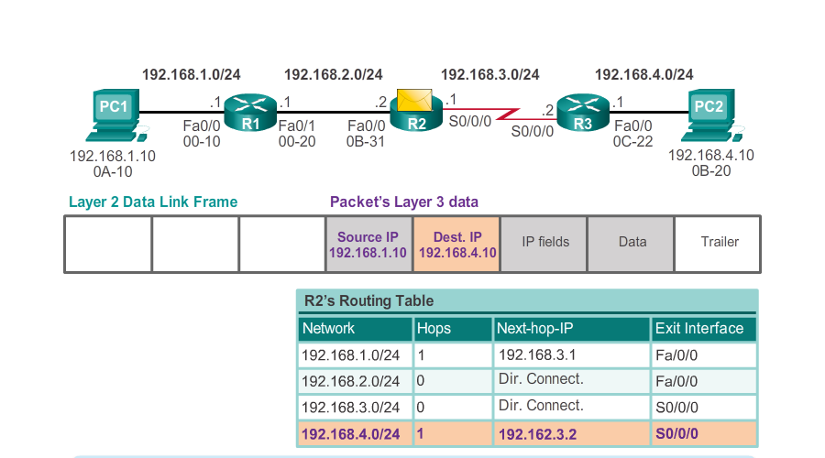
Send a packet – router to router

Slide 15
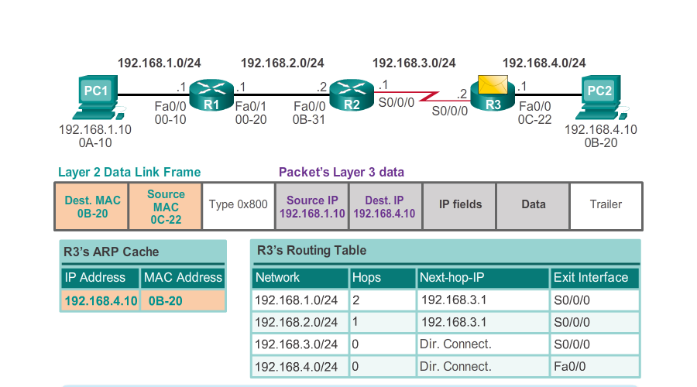
Send a packet – router to destination

Slide 16
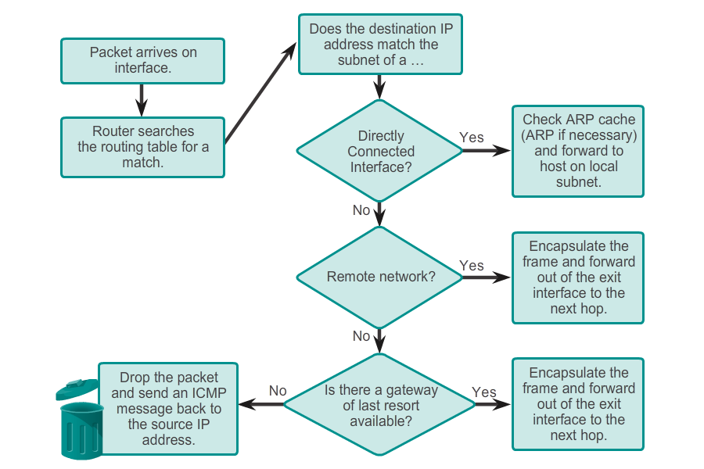
Packet forwarding decision process

Slide 17
Best path?
What is the best route from Plymouth to Heathrow?

Slide 18
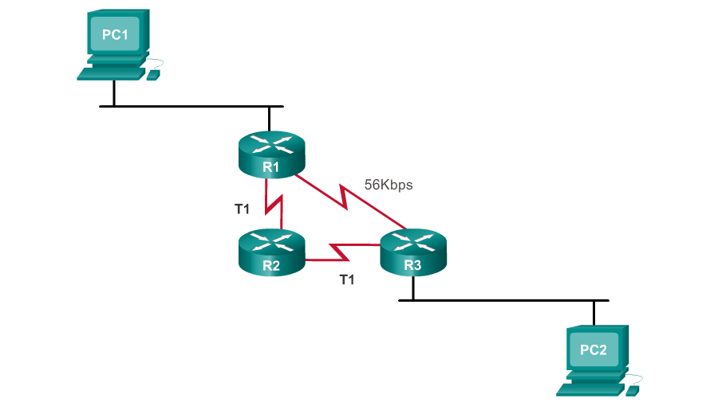
Best path?

Slide 19
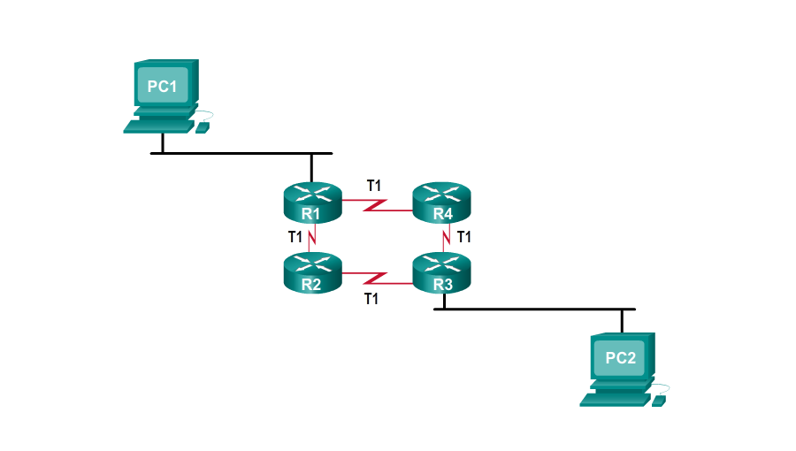
Load balancing

Slide 20
Administrative distances
Define the preference of a routing source.
Each routing source - prioritized in order of most- to least-preferable using an administrative distance value.
Cisco routers use the AD feature to select the best path when it learns about the same destination network from two or more different routing sources.

Slide 21
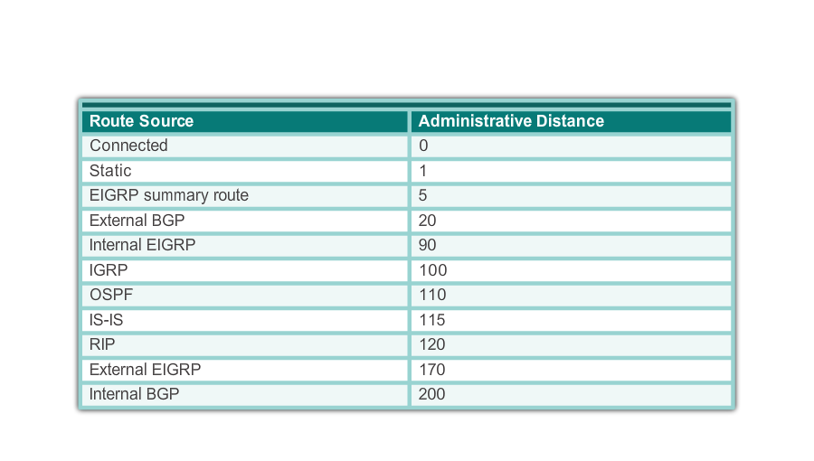
Administrative distances

Slide 22
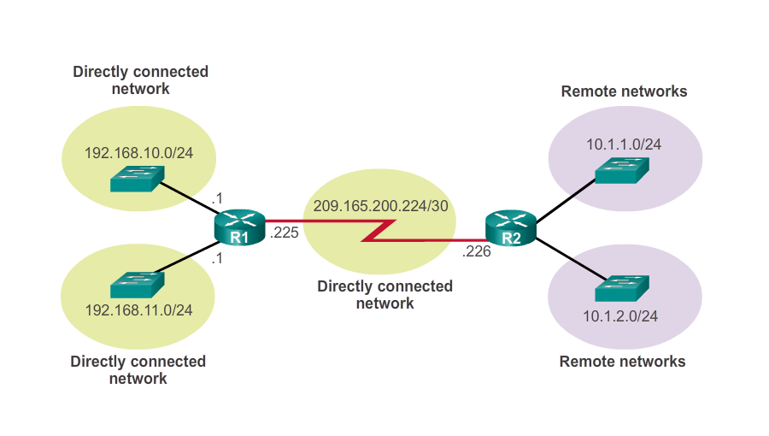
The routing table

Slide 23
The routing table
Local Route interfaces - Added when an interface is configured and active. This entry is only displayed in IOS 15 or newer for IPv4 routes and all IOS releases for IPv6 routes.
Directly connected interfaces - Added to the routing table when an interface is configured and active.
Static routes - Added when a route is manually configured and the exit interface is active.
Dynamic routing protocol - Added when routing protocols that dynamically learn about the network, such as EIGRP or OSPF, are implemented and networks are identified.

Slide 24
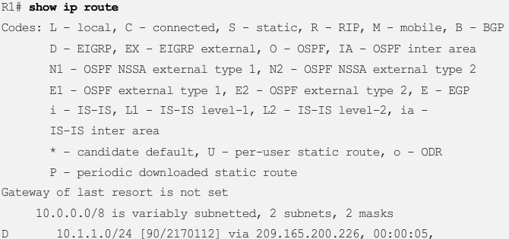
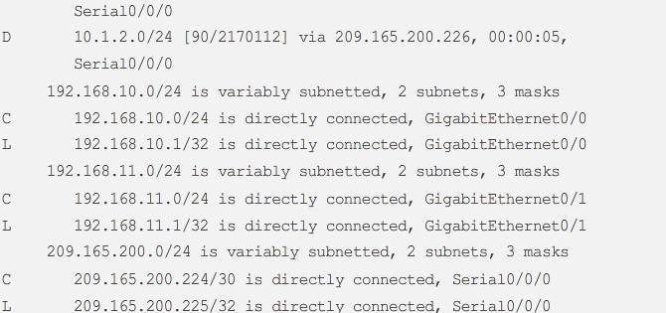
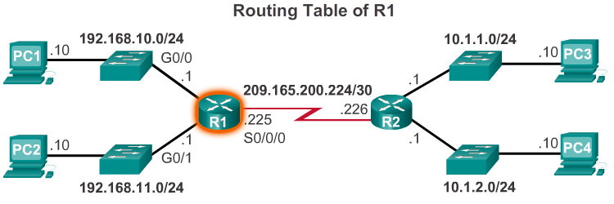
The routing table

Slide 25
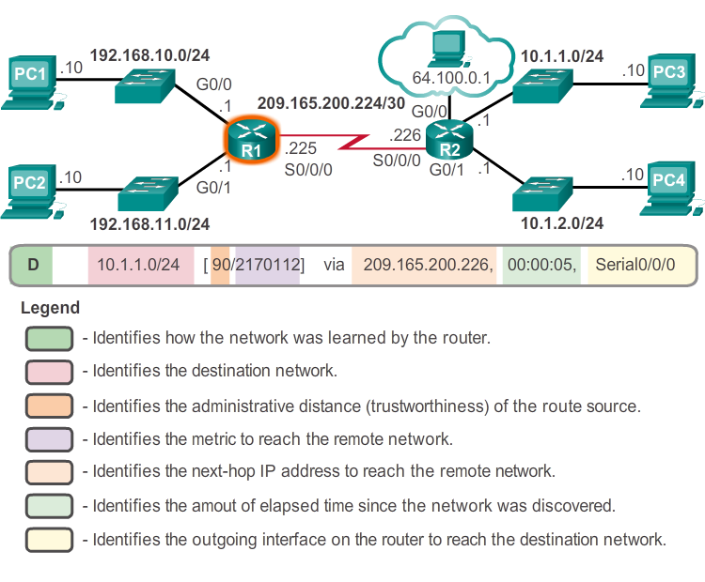
Routing entries

Slide 26
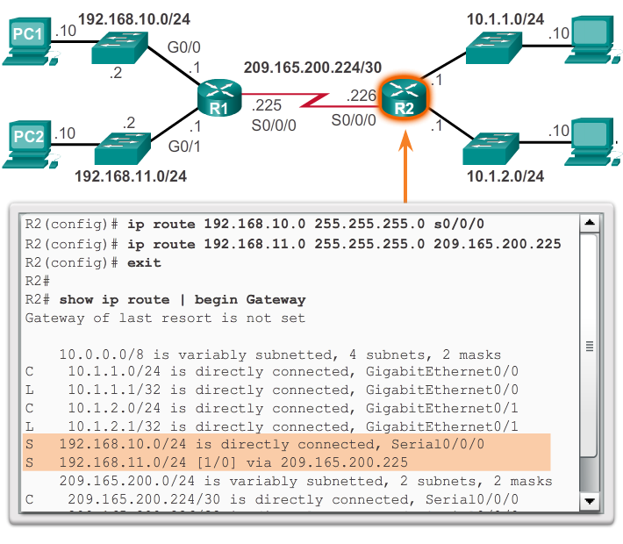
Static routes

Slide 27
Static routing
Not advertised over the network - better security.
Less bandwidth than dynamic routing protocols
No CPU cycles are used to calculate and communicate routes.
The path a static route uses to send data is known.
Initial configuration and maintenance is time-consuming.
Configuration is error-prone, especially in large networks.
Admin intervention - required to maintain changing route information.
[Maintenance] does not scale well with growing networks
Requires complete network knowledge of whole network for proper implementation.

Slide 28
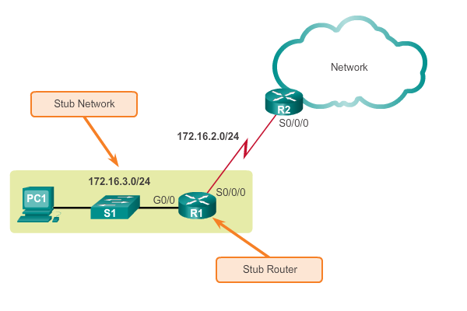
Static routes to/from stub networks

Slide 29
When to use static routes
Connect to a specific network
Connect a stub router
Summarize routing table entries
Create a backup route
Types:
Standard static route
Default static route
Summary static route
Floating static route

Slide 30
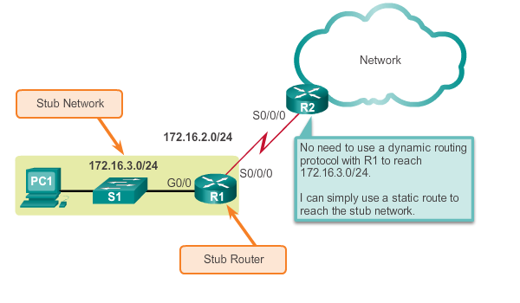
Standard static routes

Slide 31
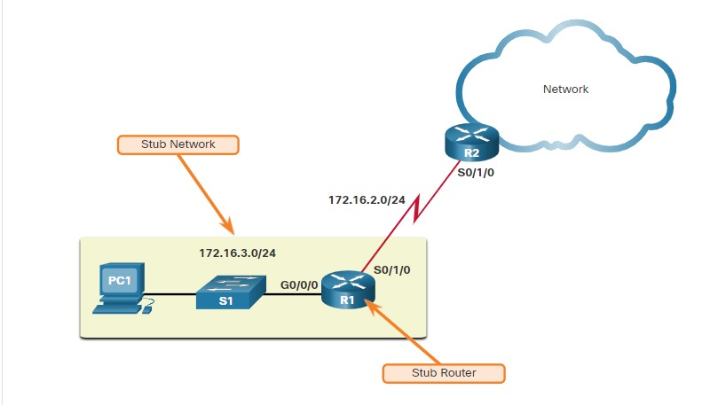
Default static routes
Set a default static route in R1 to point to R2 for all traffic going to Internet.

Slide 32
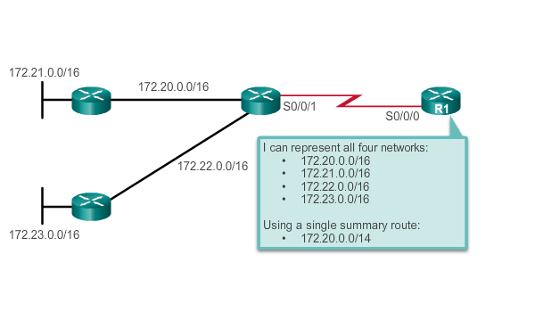
Summary static routes
Multiple static routes can be summarized into a single static route if:
Destination networks are contiguous and can be summarized into a single network address.
Multiple static routes all use the same exit interface or next-hop IP address.

Slide 33
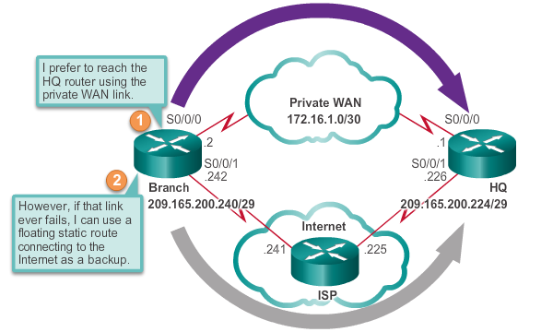
Floating static routes
Backup route for a dynamic primary route
Higher AD

Slide 34
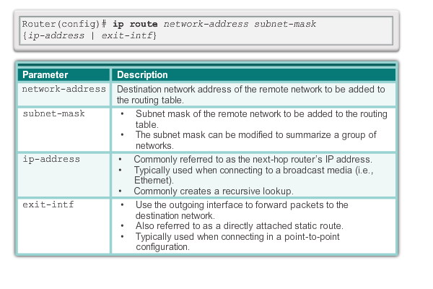
Configure static routes

Slide 35
Specifying next hop
Next-hop route - Only the next-hop IP address is specified.
Directly connected static route - Only the router exit interface is specified.
Fully specified static route - The next-hop IP address and exit interface are specified.

Slide 36
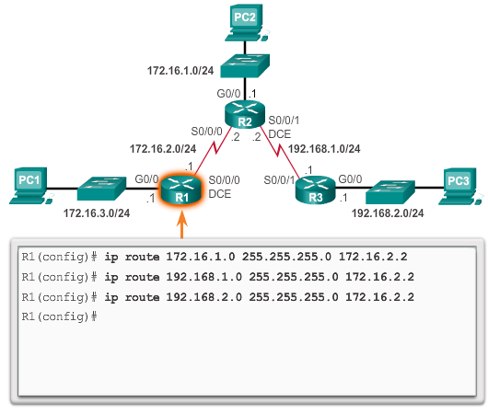
Configure next-hop static routes

Slide 37
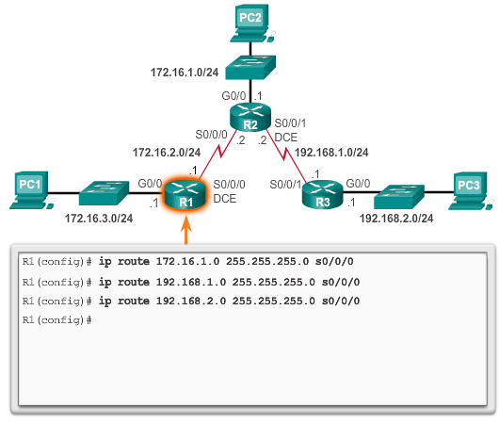
Configure directly connected static routes

Slide 38
Next-hop vs directly connected
Configuring a directly connected static route with an exit interface allows the routing table to resolve the exit interface in a single search, instead of two.
Although the routing table entry indicates “directly connected”, the AD of the route is still 1.
Only a directly connected interface can have an administrative distance of 0.
point-to-point interfaces - point to the exit interface or to the next-hop address.
multipoint/broadcast interfaces - point to a next-hop address.

Slide 39
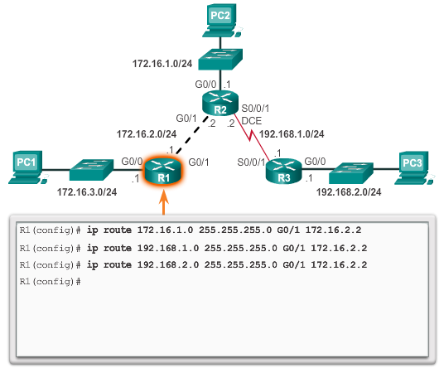
Fully specified static routes

Slide 40
Verify static routes
ping and traceroute
show ip route
show ip route static
show ip route network

Slide 41
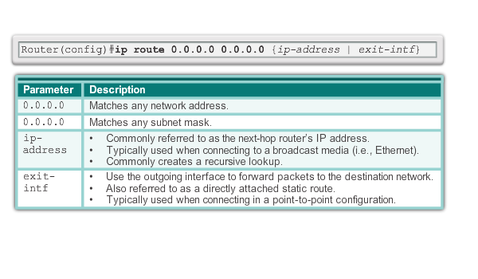
Default static route syntax

Slide 42
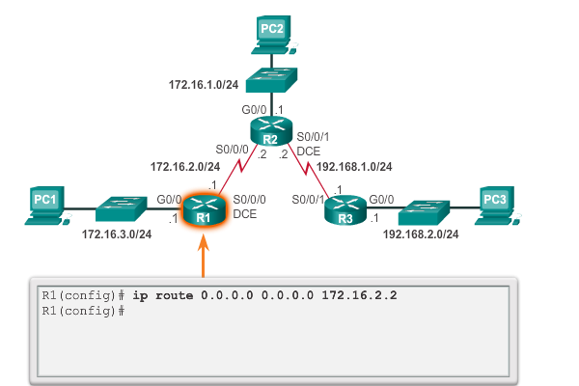
Configure a default static route

Slide 43
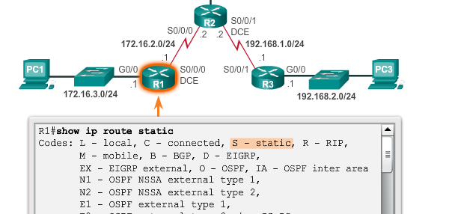
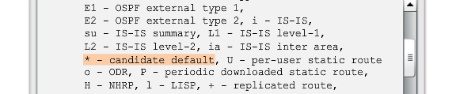
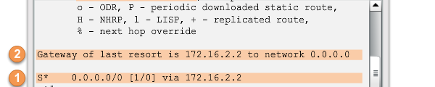
Verify a default static route

Slide 44
Next-hop options
The next hop can be identified by an IPv6 address, exit interface, or both. How the destination is specified creates one of three route types:
Next-hop static IPv6 route - Only the next-hop IPv6 address is specified.
Directly connected static IPv6 route - Only the router exit interface is specified.
Fully specified static IPv6 route - The next-hop IPv6 address and exit interface are specified.

Slide 45
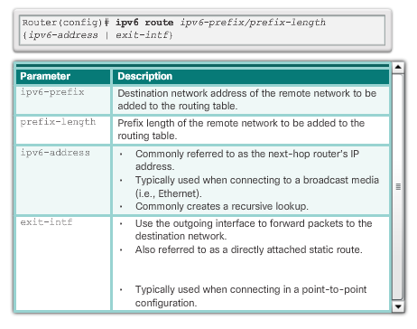
IPv6 route command
show ipv6 route
ping ipv6 ipv6_address

Slide 46
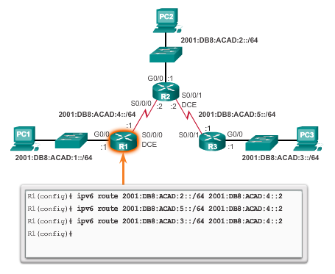
Next hop static ipv6 routes

Slide 47
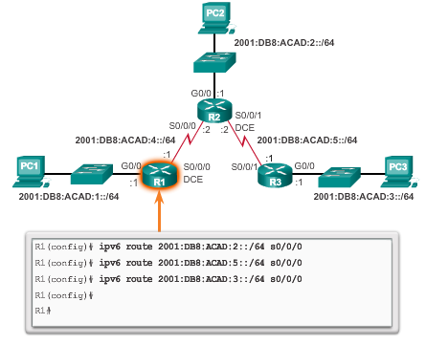
Directly connected ipv6 static route

Slide 48
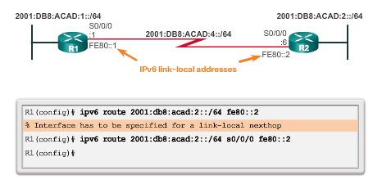
Fully specified ipv6 static route

Slide 49
Default static ipv6 route
R(config)# Ipv6 route ::/0 {ipv6-address | exit-intf}

Slide 50
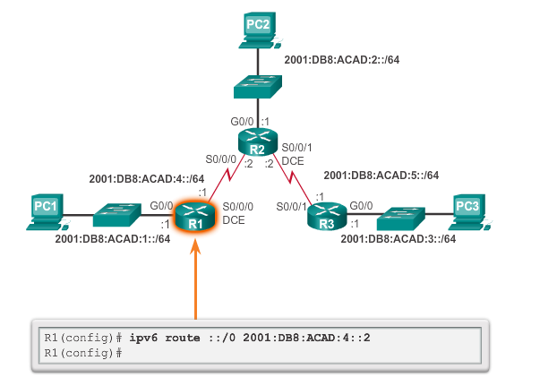
Default static ipv6 route

Slide 51
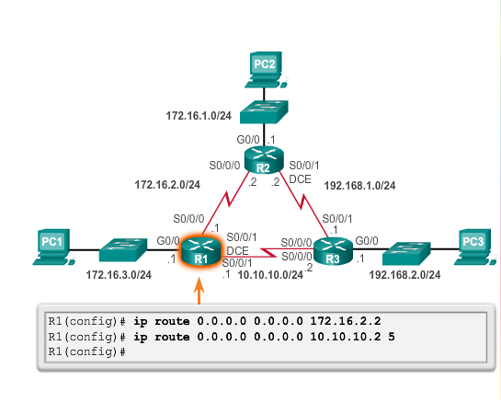
Configure a floating static route

Slide 52
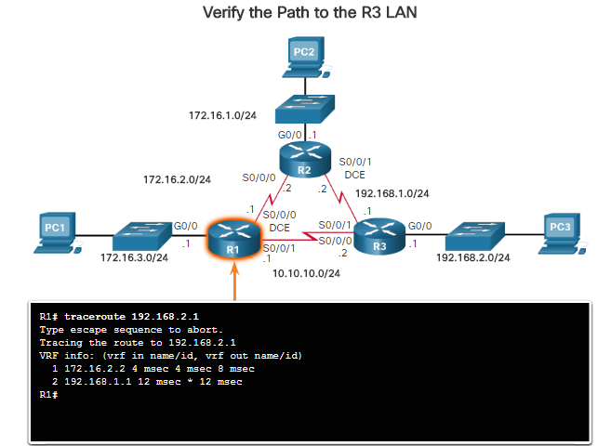
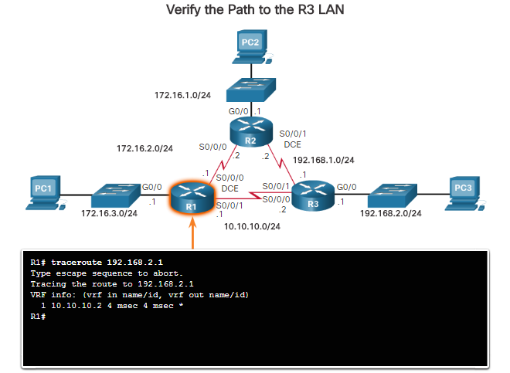
Test a floating static route
When R2 serial interfaces are shutdown.

Slide 53
Troubleshooting
ping
traceroute
show ip route
show ip interface brief
show cdp neighbors detail

Slide 54
Summary
Router functionality
Routing decisions and operation
Switching packets between networks
Path determination
The routing table
Types of routes
Static routes
IPv4 and IPv6
Directly connected, default, floating
Configuration
Troubleshooting

Slide 55
Activities and labs
15.6.1– Packet Tracer - Configure IPv4 and IPv6 static and default routes

